Slide 1


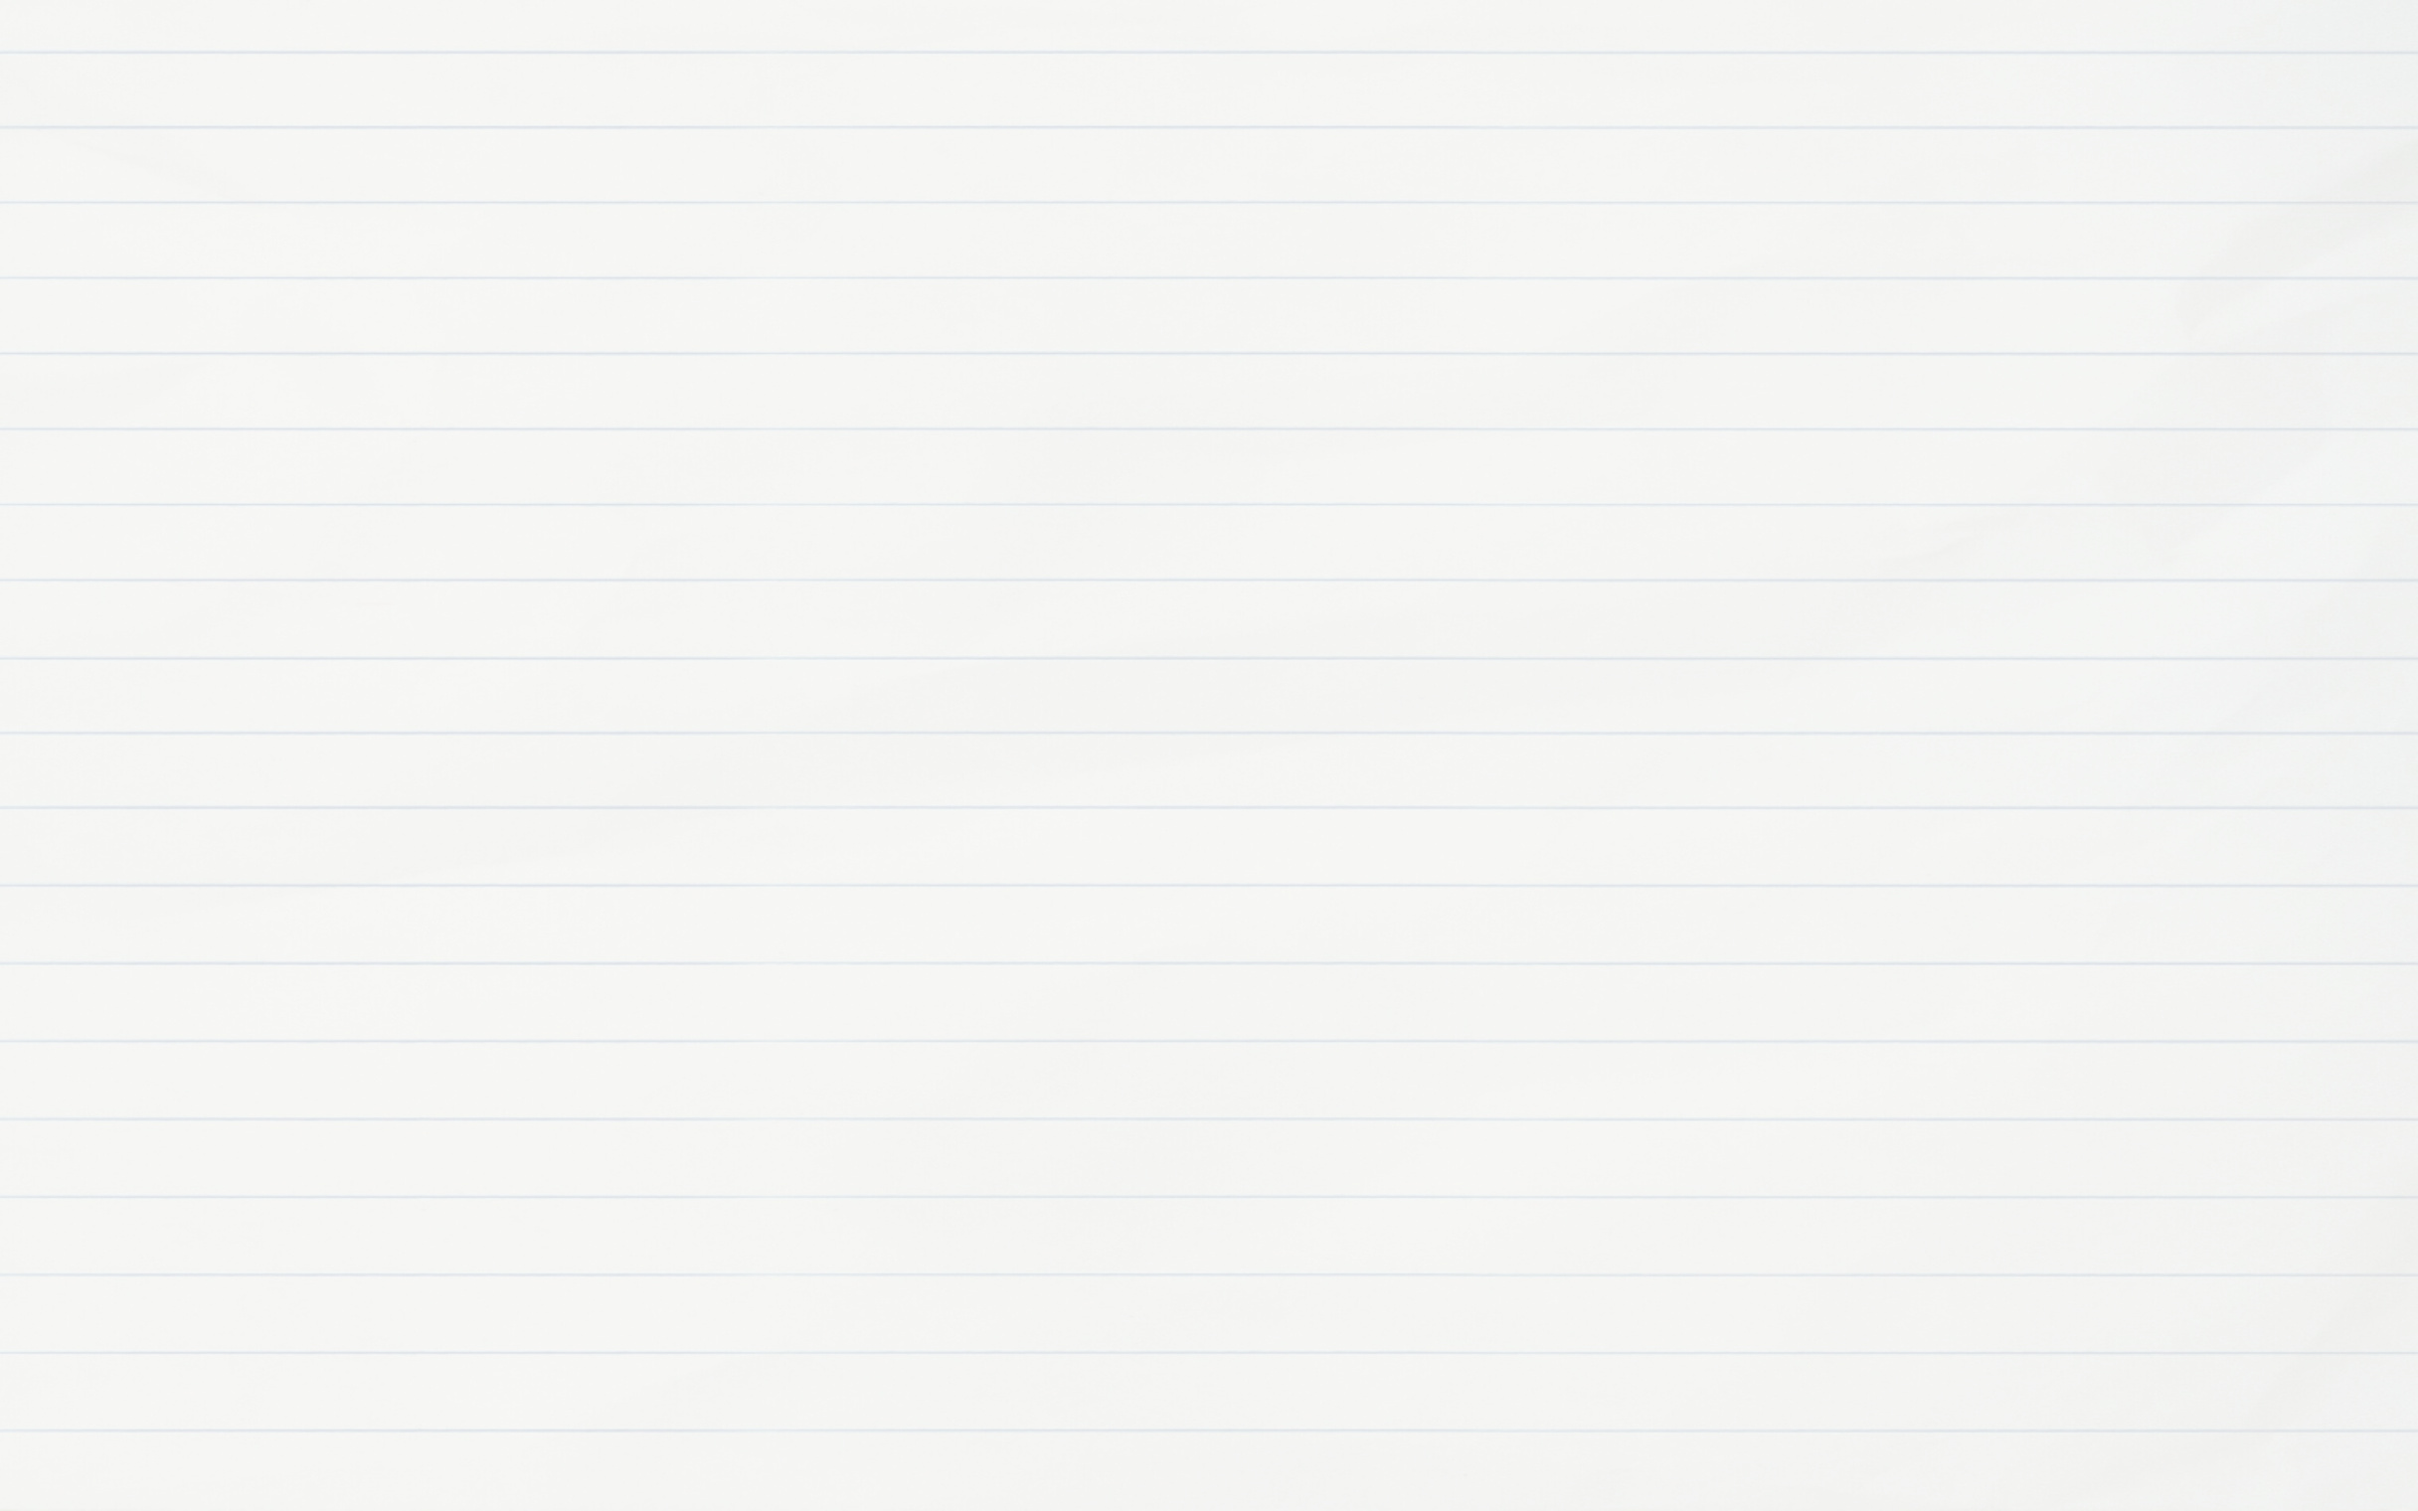



Fran, Quique, Alex, Carles and Xavier
Estubook

Slide 2

Index
Programming
Scene Builder
HTML and CSS
Databases
Diagrams
Web Server
GitHub
MockUps

Slide 3



Programming
General concept
We started programming doing just the basics of the program focusing on what was made with Scene Builder

Slide 4


Scenne Builder
We created the base of the windows. Thanks to this, we began to program the aplication with what we had in the moment.

Slide 5

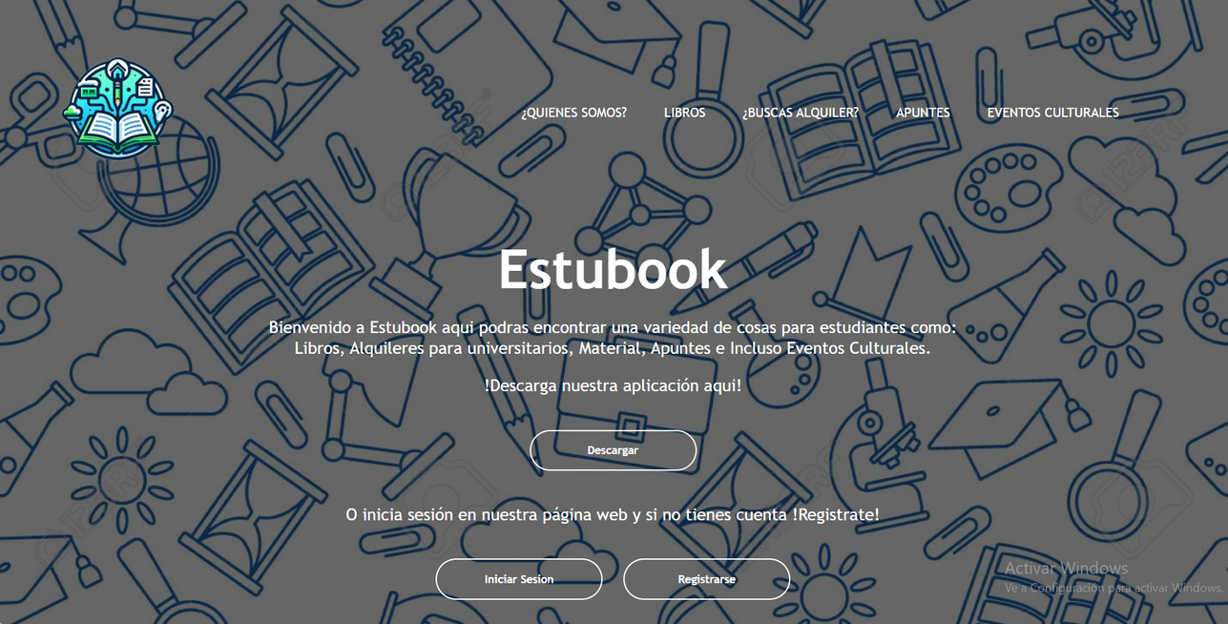

HTML and CSS
We made the web with BootStrap. Once the structure of the web was completly made, we gave it some style with css and some JavaScript.

Slide 6
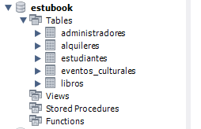


Databases
We created the database which later will be implemented in the web and in the aplication. After that, we created consults and triggers to the database.

Slide 7
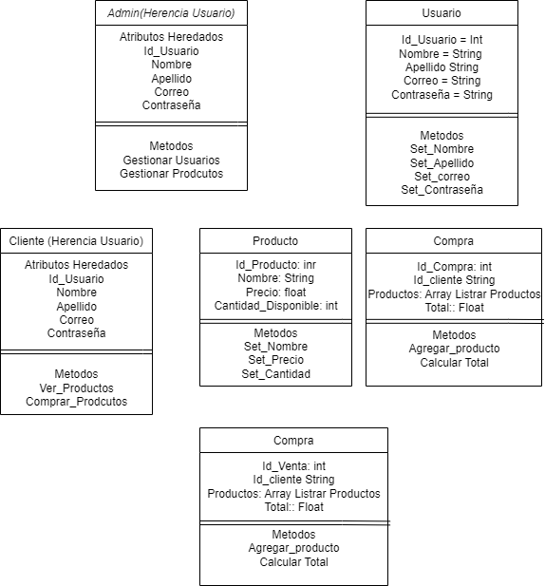

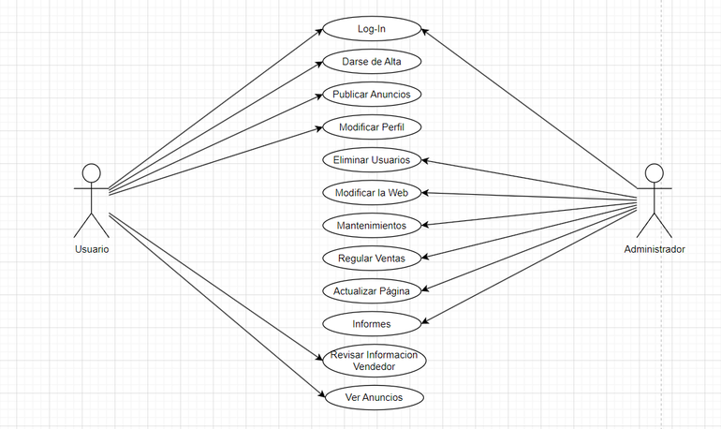
Diagrams
Different diagrams have been created. Class diagram, diagram of case of uses and secuency diagram where necessary.

Slide 8

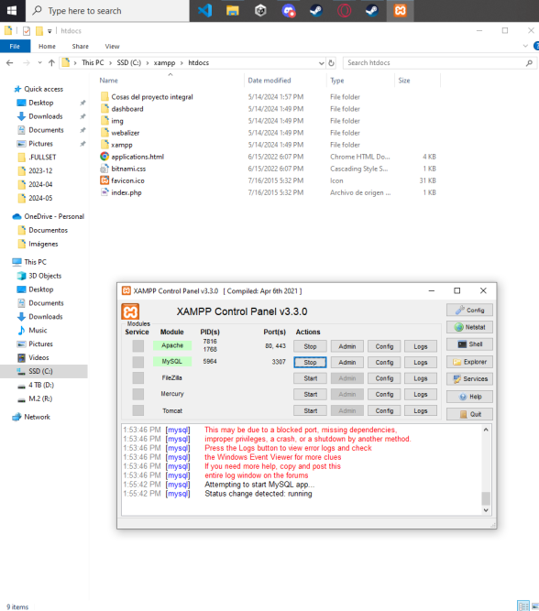

Web Server
We created a server wich purpose is to mantain our web online.

Slide 9
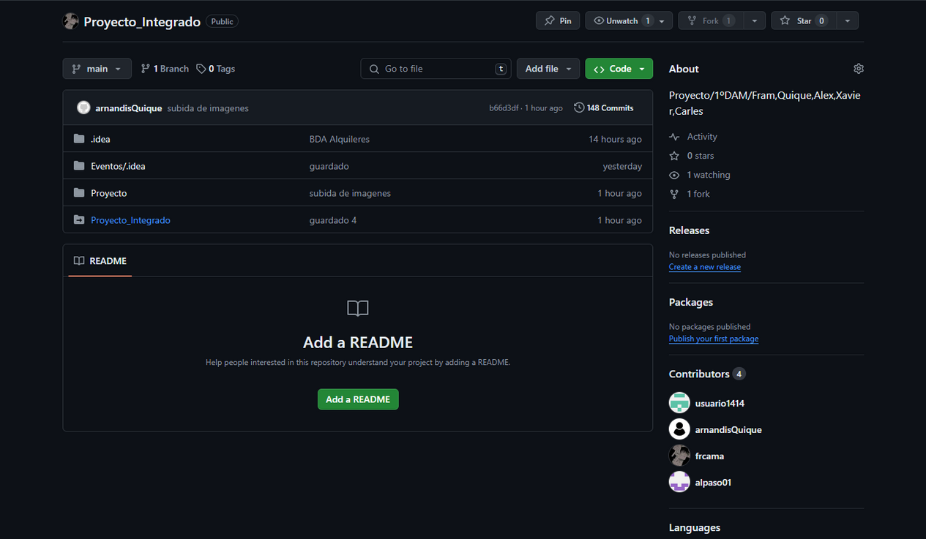

Git Hub
What GitHub was used for was to create a repository were later it would be connected to the programming interface. THis way we could upload a dialy commit to it.

Slide 10
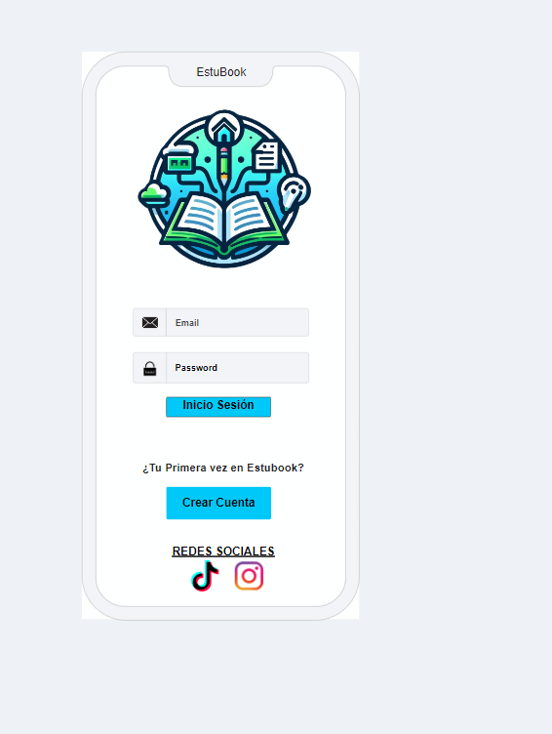
MockUps
We used and altered the mockup to use it as our base for building the style of the aplication itself.

Slide 11

Thank you
for your time

